Slide 1
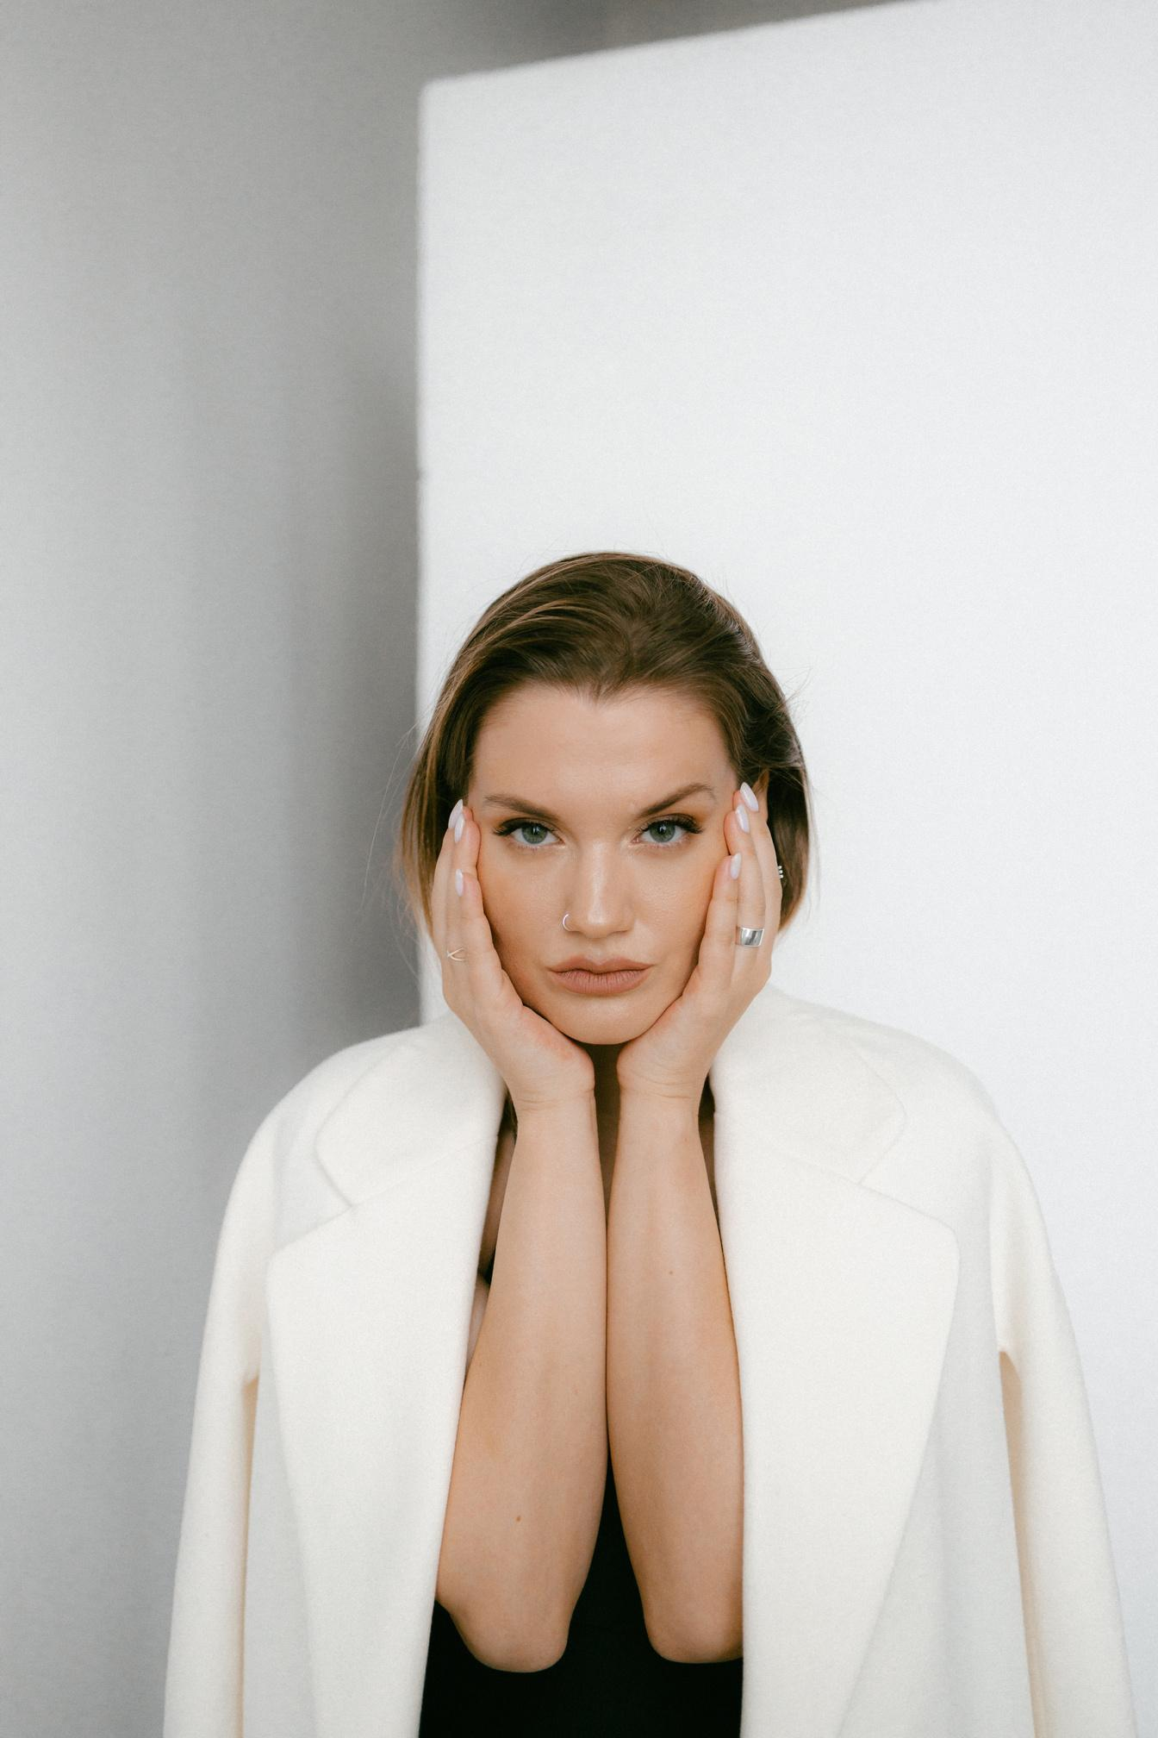
Fashion Trend Forecasting
Team 12
Jiaying (Grace) Zheng
Hazel Huang
Shuhan(Judy) Wang
Yu-Ning Yu

Slide 2
01
04
Background
Implications & Recommendations
02
05
Context
Data Description & Methodology
Limitations
03
Results & Findings

Slide 3
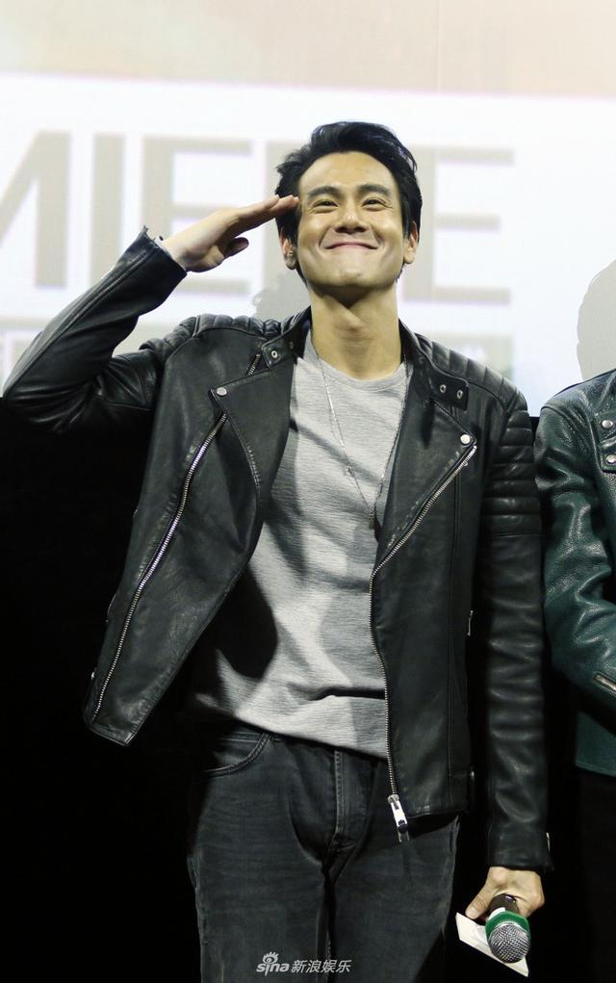
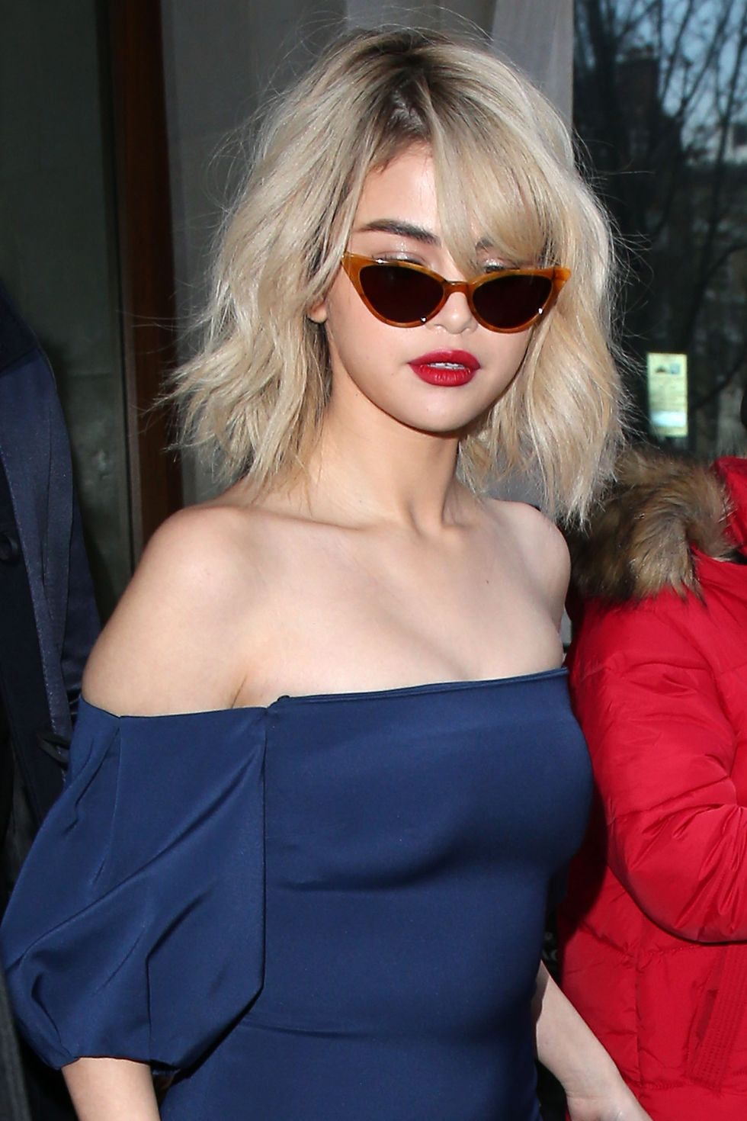
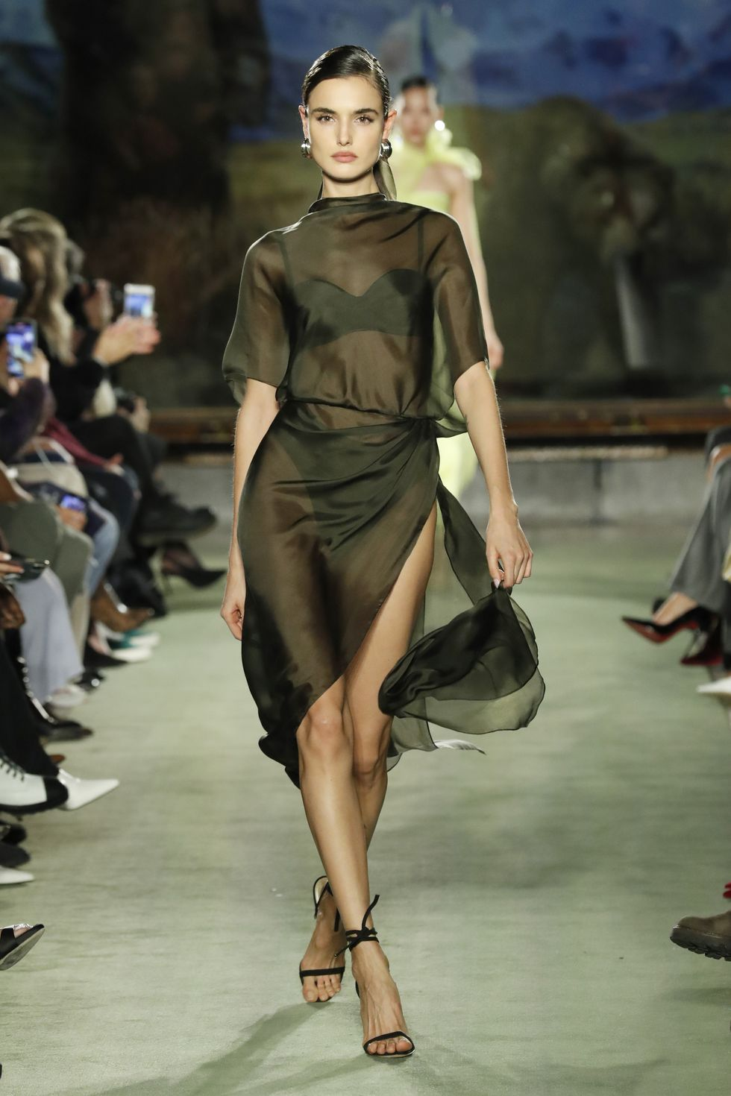
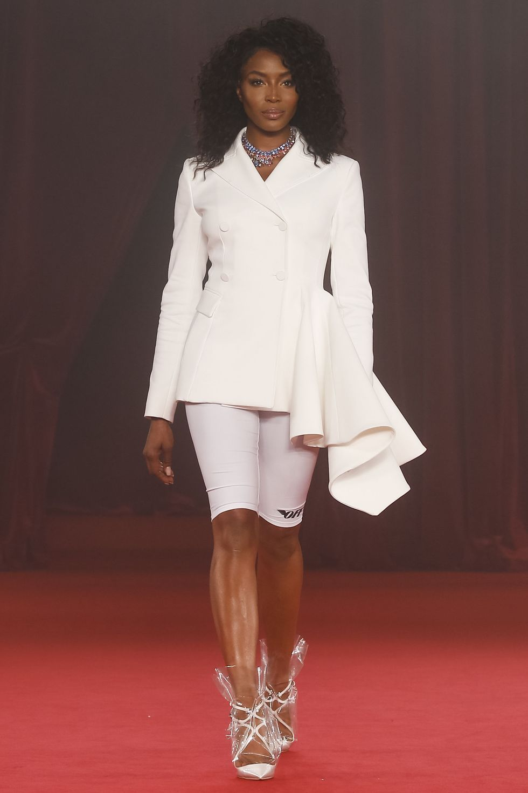
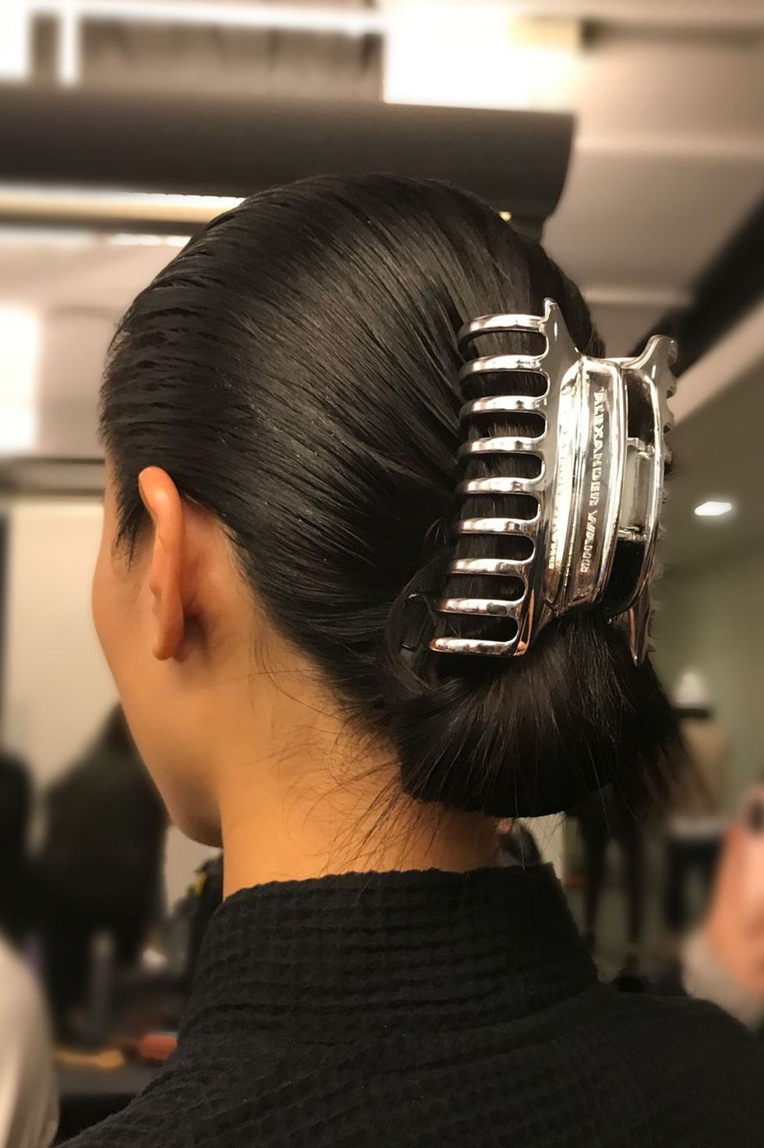
“What goes around comes around”
Notes:
https://www.cosmopolitan.com/style-beauty/fashion/g18923532/popular-1990s-fashion-trends/

Slide 4
Introduction
This analysis investigates the cyclical nature of specific fashion trends and aims to forecast their future cycles to benefit fashion enthusiasts and brands.
Problem
Fashion brands and buyers
E-commerce platforms
Fashion enthusiasts and influencers
Stakeholders

Slide 5
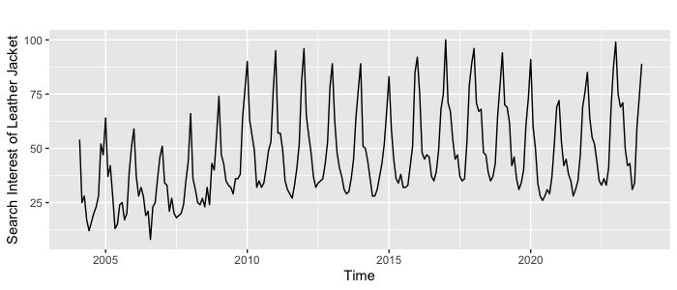
Data Description
The main variable in this study is the search interest* of the leather jacket at Google website in Los Angeles area with monthly data scale from 2004 to 2023 Nov.
*Search Interest: represent the popularity of the search term. A value of 100 is the peak popularity for the term. A value of 50 means that the term is half as popular.
Level, trend, seasonality, and noise
Data source: Google Trend
Notes:
To capture the fashion trend, we believe search volume at google is a good proxy to evaluate the popularity of specific product, so we leverage google trend data and collect monthly data from 2004 to 2023 Nov.
The main variable of this study is the search interest.
Definition of search interest is the popularity of the search term.
So in our example of the leather jacket trend, a value of 100 is the peak popularity of the leather jacket. A value of 50 meaning half of the popularity of the search term

Slide 6
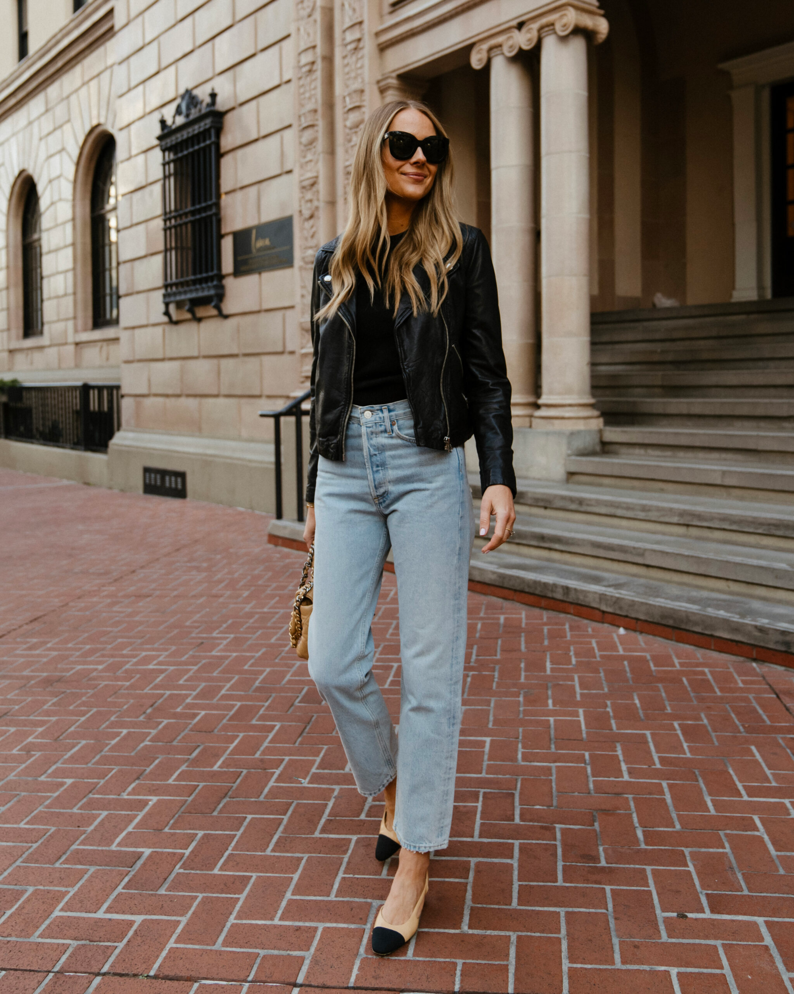
Methodology
1.
Data Pre Processing
We perform classical decomposition first to understand the level, trend, seasonality, and noise from the dataset. We selected the period from 2004 to 2021 as training period, and 2021-2023 as the testing period.
Model Fitting
We explore different models, including Seasonal Naive Forecasting, Moving Average, Holt Winter’s Exponential Smoothing, ARIMA, and NNETAR. After that, we fit models with validation sets and choose the one with the least residuals.
2.
3.
Model Forecasting
We forecast future value of 2023 Nov - 2024 Nov using Moving Average and ARIMA models

Slide 7
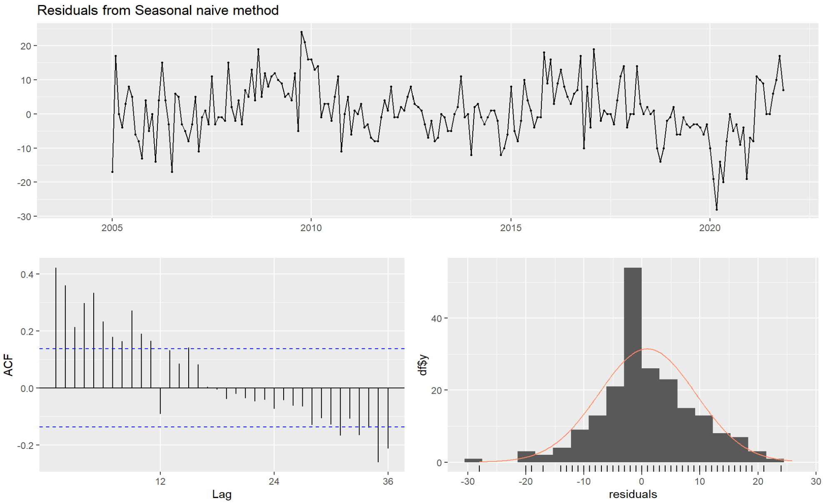
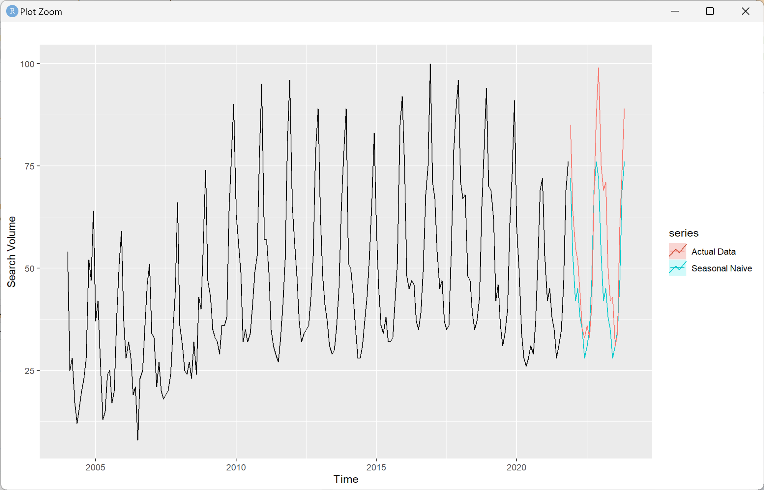
Seasonal Naive Forecasting
 | RMSE | MAPE
Training | 8.369249 | 15.93752
Testing | 13.159281 | 16.70597

Slide 8
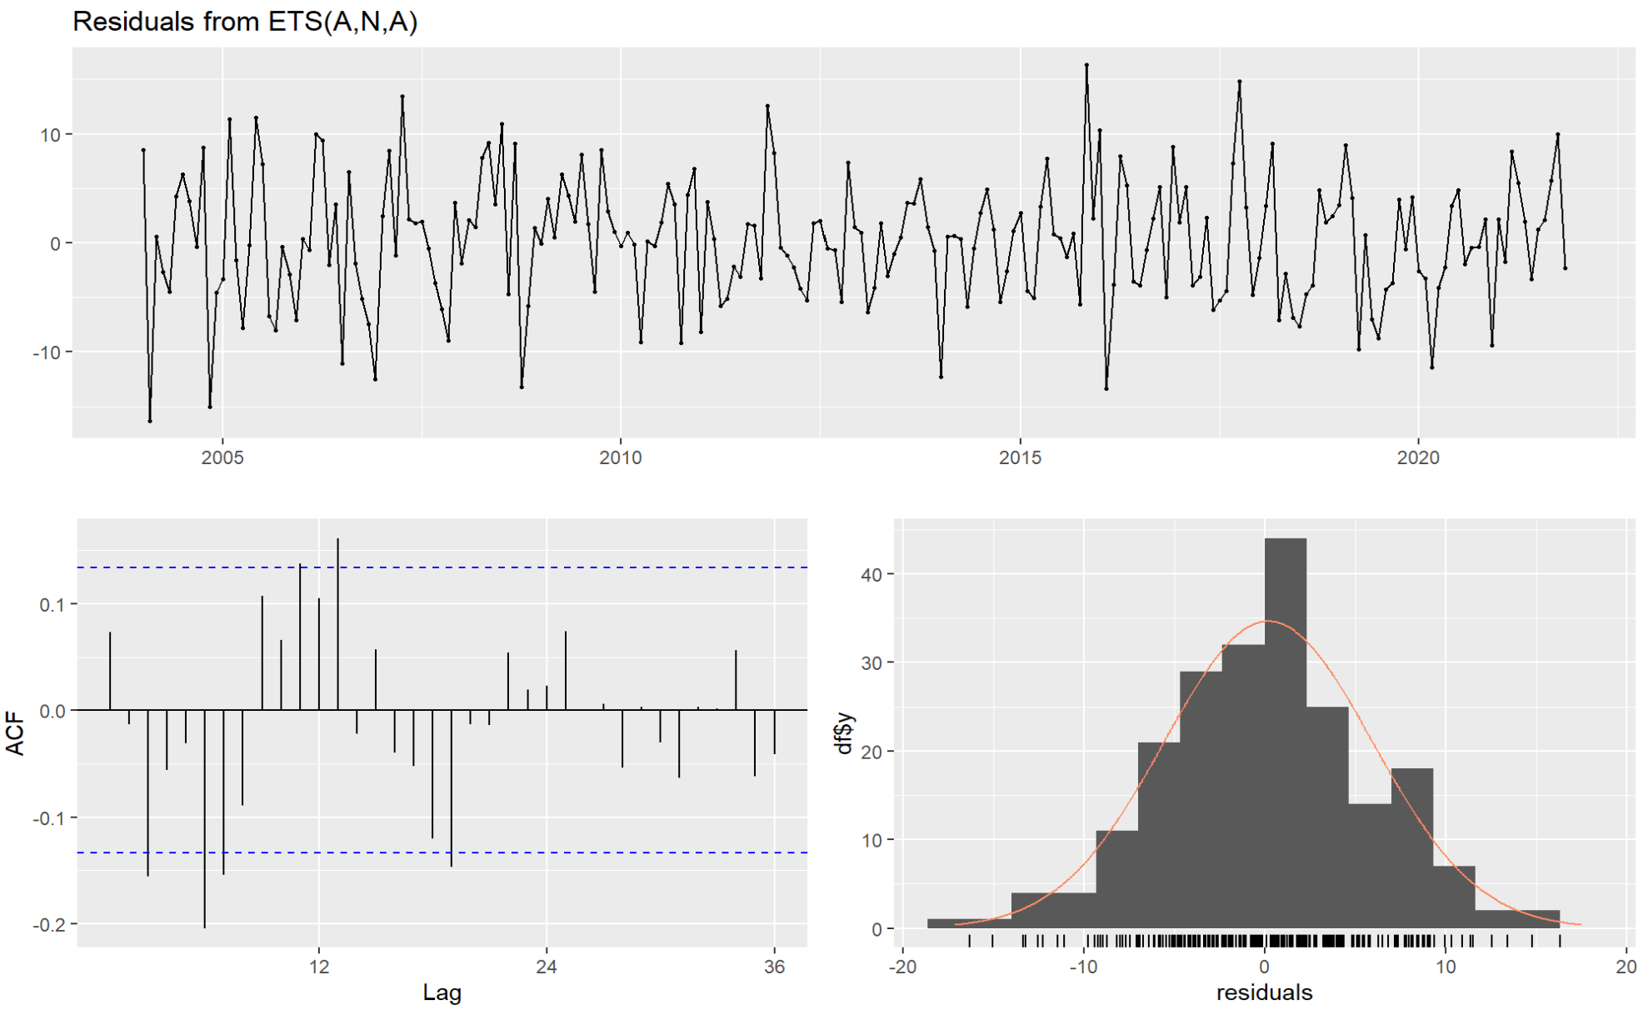
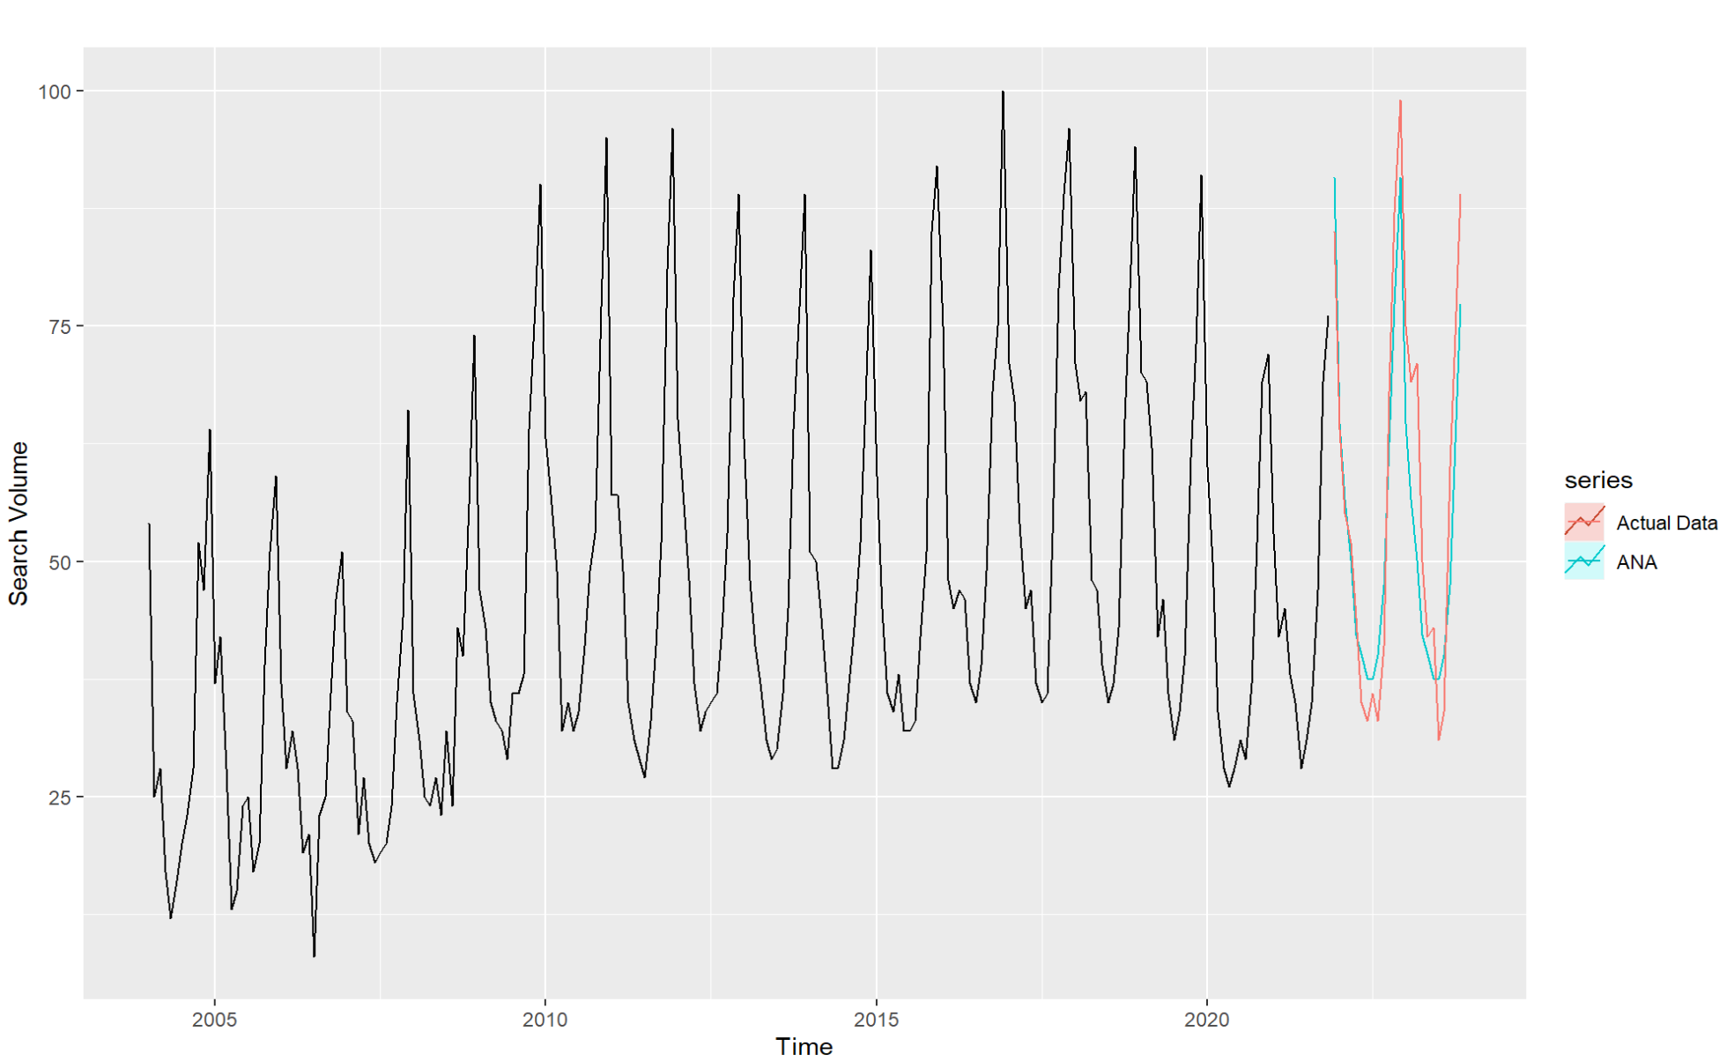
Holt-Winter's Exponential Smoothing
 | RMSE | MAPE
Training | 5.759327 | 12.20105
Testing | 8.352767 | 12.42509

Slide 9
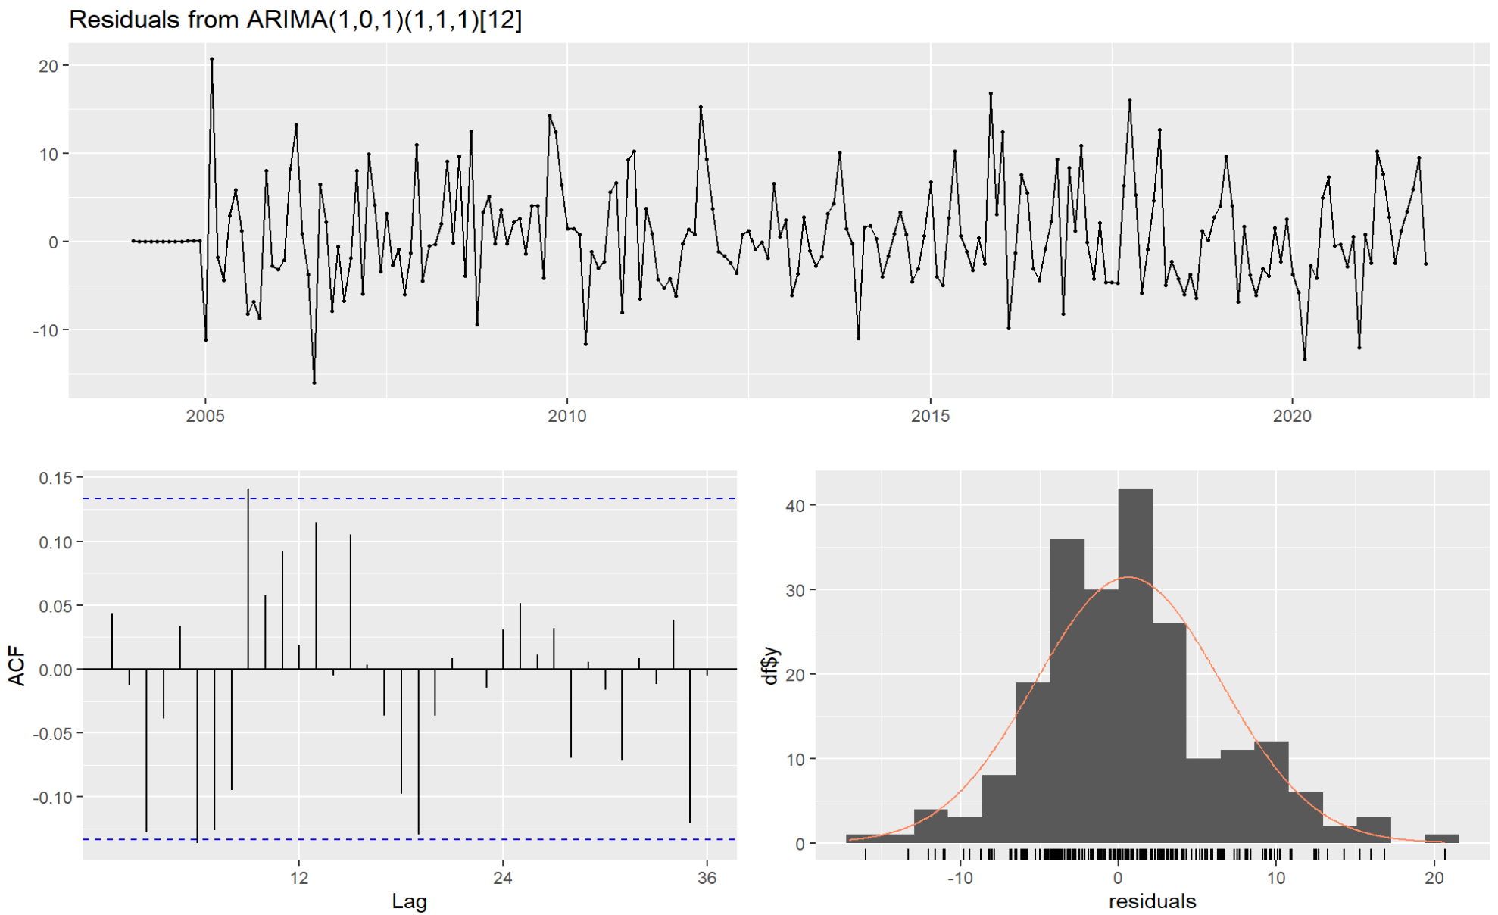
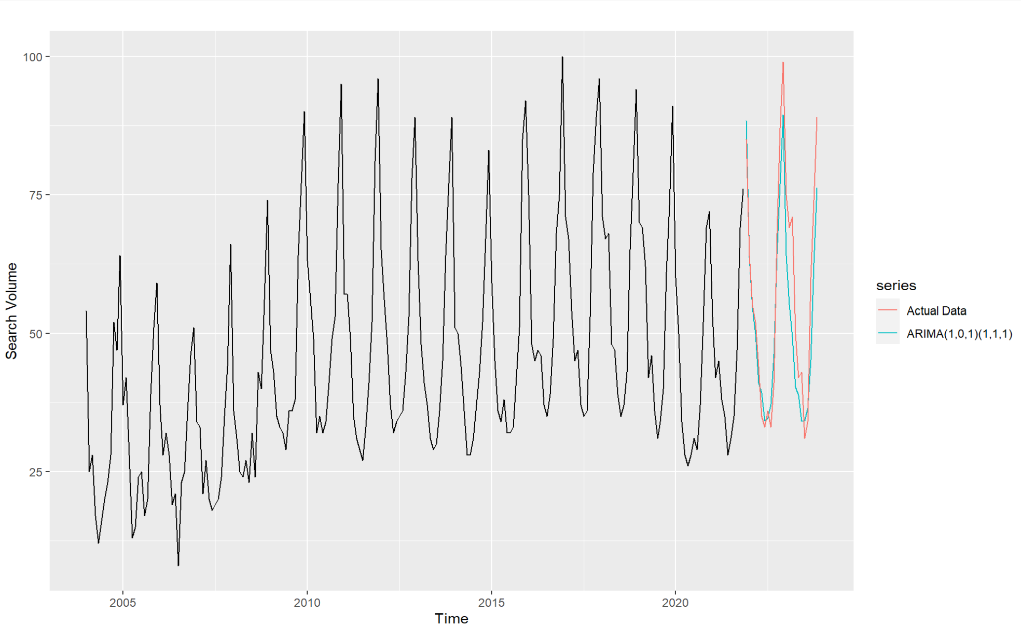
ARIMA Model
 | RMSE | MAPE
Training | 5.897617 | 11.38434
Testing | 8.638583 | 11.36311

Slide 10
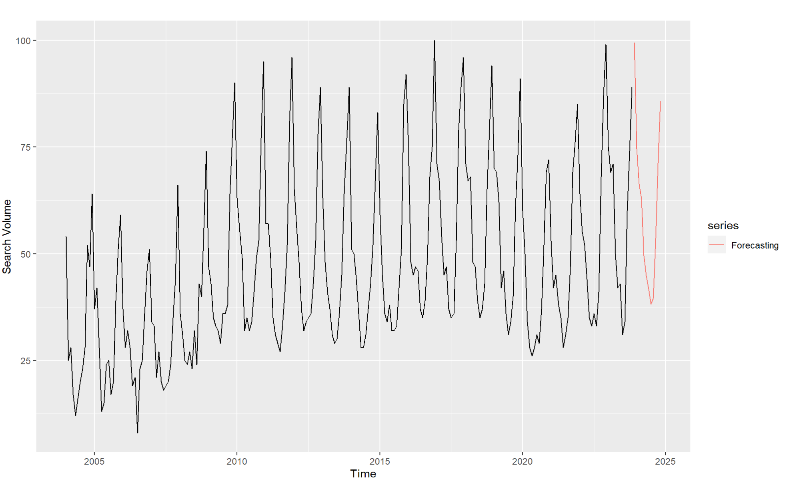
ARIMA Model Future Prediction

Slide 11
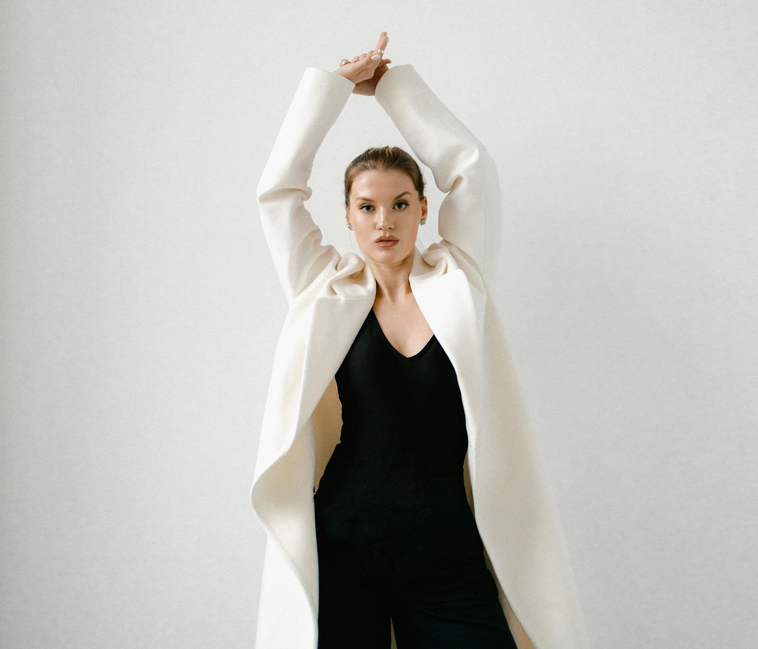
Implications & Recommendations
Forecasted Leather Jacket Popularity: In our forecast for the popularity of leather jackets in the year 2024, the results derived from ARIMA models indicate that consumer interest in these jackets peaks during winter (November - January) and is lowest during the summer.
Recommendations: Based on the analysis on seasonality associated with the leather jackets’ popularity, we propose the following strategies for the fashion/retail companies:
Inventory Management: Adjust stock levels for leather jackets to meet heightened winter demand, ensuring a diverse range of styles and sizes. Implement lean inventory practices in summer to prevent excess stock and potential markdowns.
Targeted Marketing Campaigns: Launch targeted advertising campaigns, promotions, and social media initiatives during the peak winter months to capture consumer attention. During the summer, consider running clearance sales or promotions on leather jackets.
Content Creation by Fashion Influencers: Fashion Influencers can create engaging content that highlights the leather jackets, focusing on winter styling during peak months.
Notes:
Tailor marketing efforts to align with the seasonal fluctuations in leather jacket popularity.
Highlight the warmth, style, and versatility of leather jackets, emphasizing their suitability for cold weather
During the summer, emphasize on lighter outerwear.

Slide 12
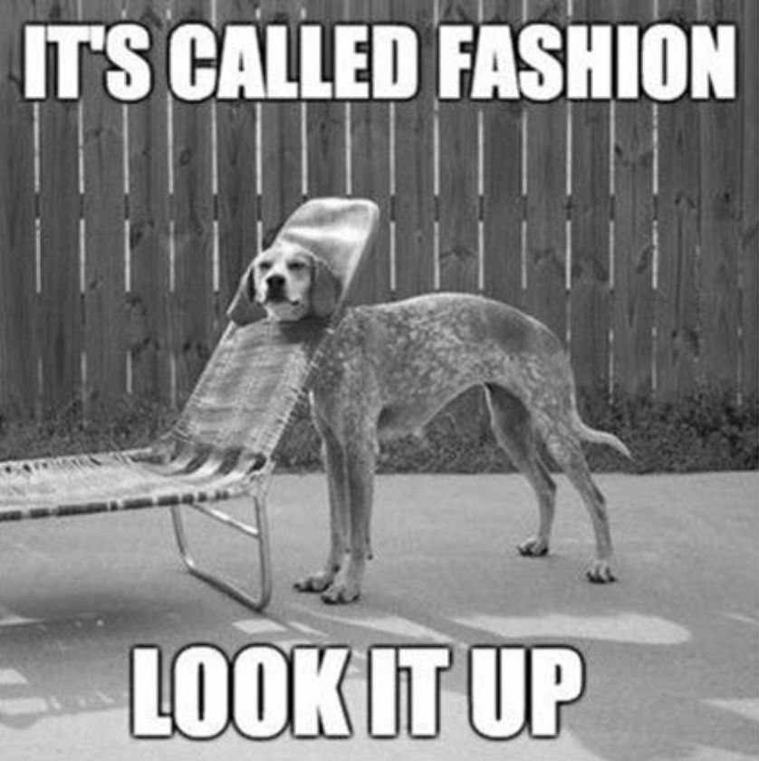
Limitations
Limited Predictive Power: A proxy for purchasing behavior
Temporal Misalignment: Time lag between searches and consumer behavior
Data quality: Not absolute search volumes
Geographical differences: Require adjustments if applied on global or national trends
External Factors: Fashion innovation, unforeseen events like pandemic, or promotions

Slide 13
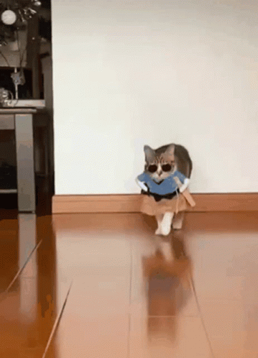
Thank you

Slide 14
Implications & Recommendations
We utilized search interest of leather jacket as a proxy for stakeholders like brands, e-commerce platforms, and fashion influencers with different implications.
Who can benefit | Brands/ E-commerce Platform | Fashion Enthusiasts/ Influencer
How to utilize the analysis | Inventory Management Product Assortment preparation Product go-to-market; marketing campaign planning | Social content preparation
Why utilizing the analysis | Optimize supply chain/ marketing costs Market products to the target audience attention at the right timing Secure competitive advantages | Meet satisfaction of capturing the most on trend products Grab attention from the targeted fans

